Slide 1
Time Series Data – Federated Learning Pipeline
Alexander Lange

Slide 2
Dataset Background
Cellular base station metrics averaged over two-minute periods
Objective: To allow the user to train various models on a variety of time series data and compare those models for forecasting and computational performance.
Features:
Time
Downlink traffic
Uplink traffic
Number of users (rnti_count)
Modulation and Coding Scheme (MCS), a measure of signal quality
Resource Block (RB) usage

Slide 3
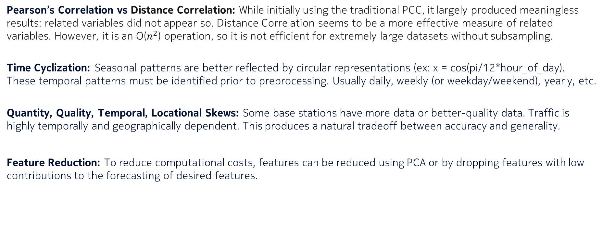
Exploratory Data Analysis
What does the data show?
Pearson’s Correlation vs Distance Correlation: While initially using the traditional PCC, it largely produced meaningless results: related variables did not appear so. Distance Correlation seems to be a more effective measure of related variables. However, it is an O($n^{2}$) operation, so it is not efficient for extremely large datasets without subsampling.
Time Cyclization: Seasonal patterns are better reflected by circular representations (ex: x = cos(pi/12*hour_of_day). These temporal patterns must be identified prior to preprocessing. Usually daily, weekly (or weekday/weekend), yearly, etc.
Quantity, Quality, Temporal, Locational Skews: Some base stations have more data or better-quality data. Traffic is highly temporally and geographically dependent. This produces a natural tradeoff between accuracy and generality.
Feature Reduction: To reduce computational costs, features can be reduced using PCA or by dropping features with low contributions to the forecasting of desired features.

Slide 4
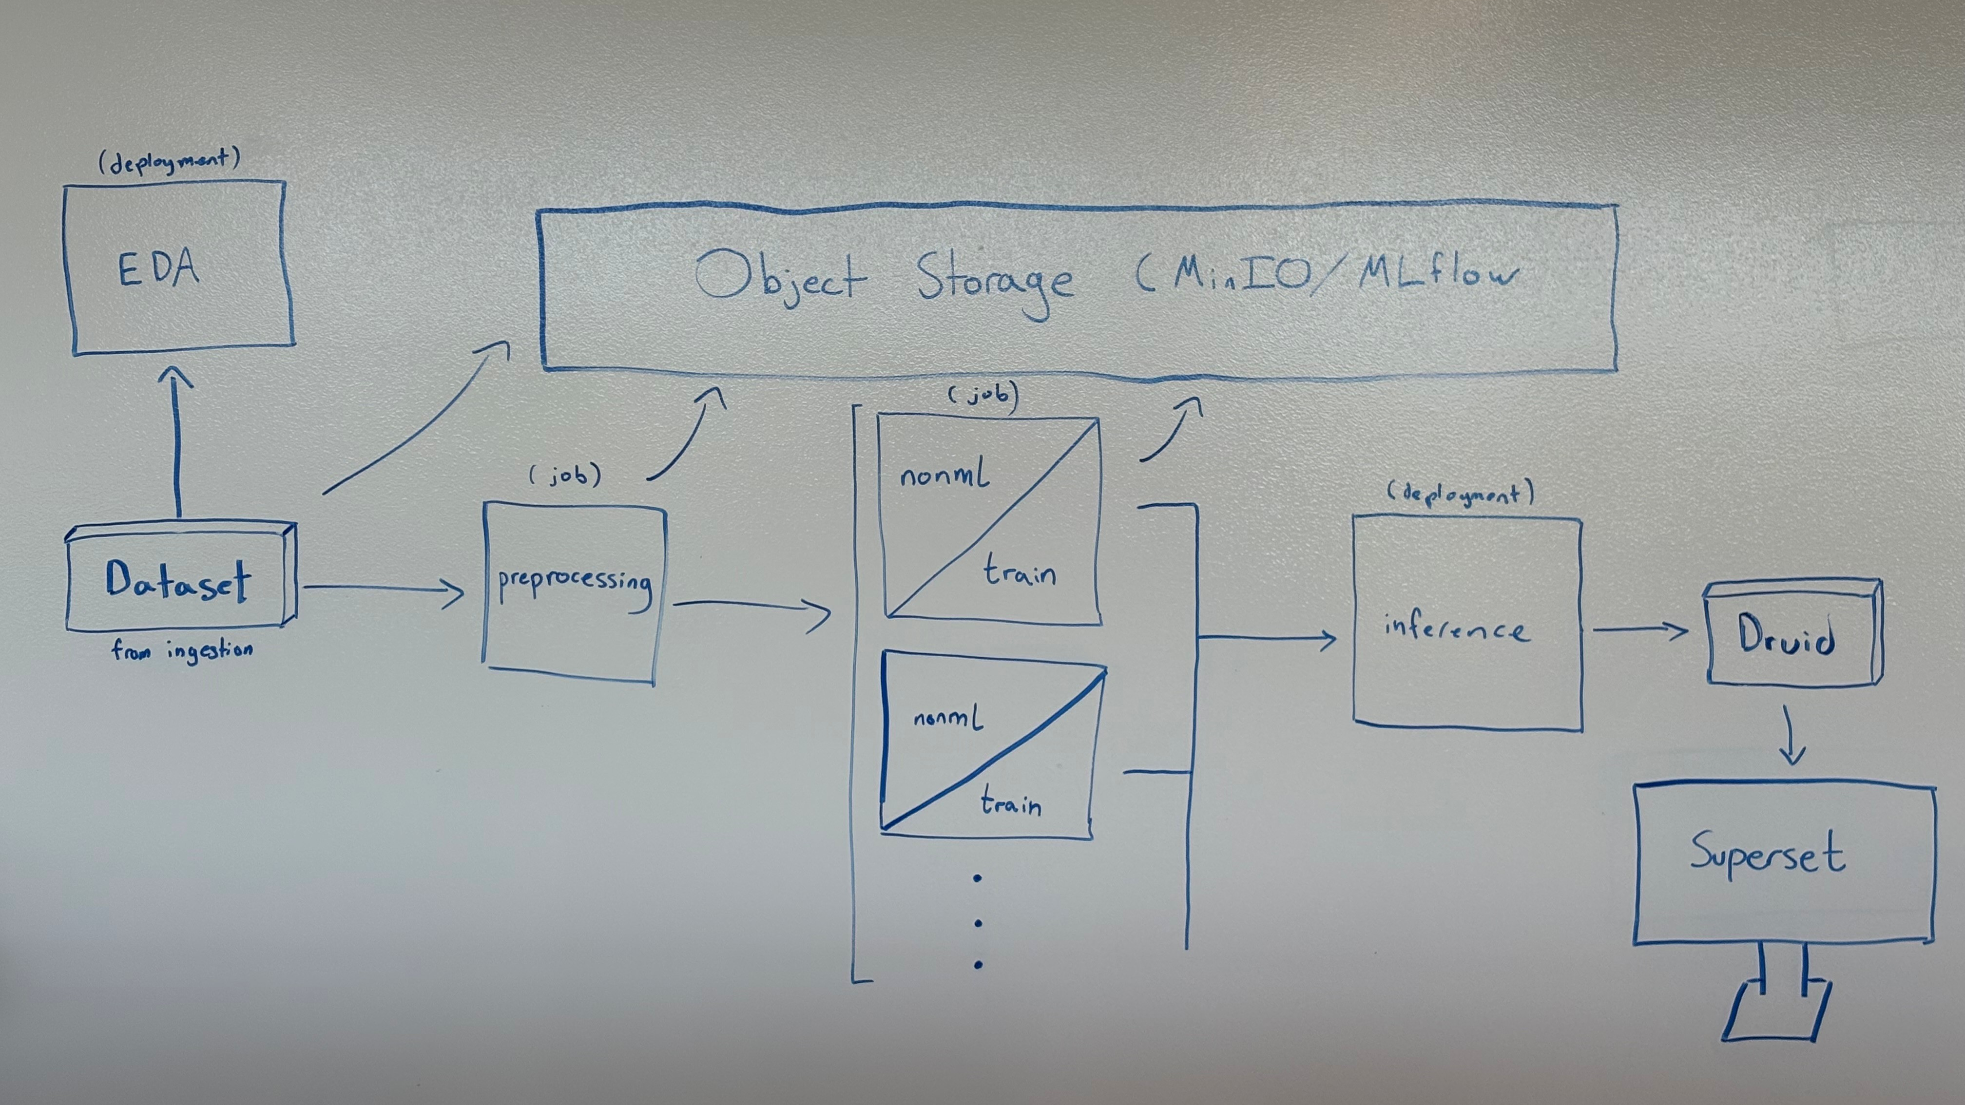

Slide 5
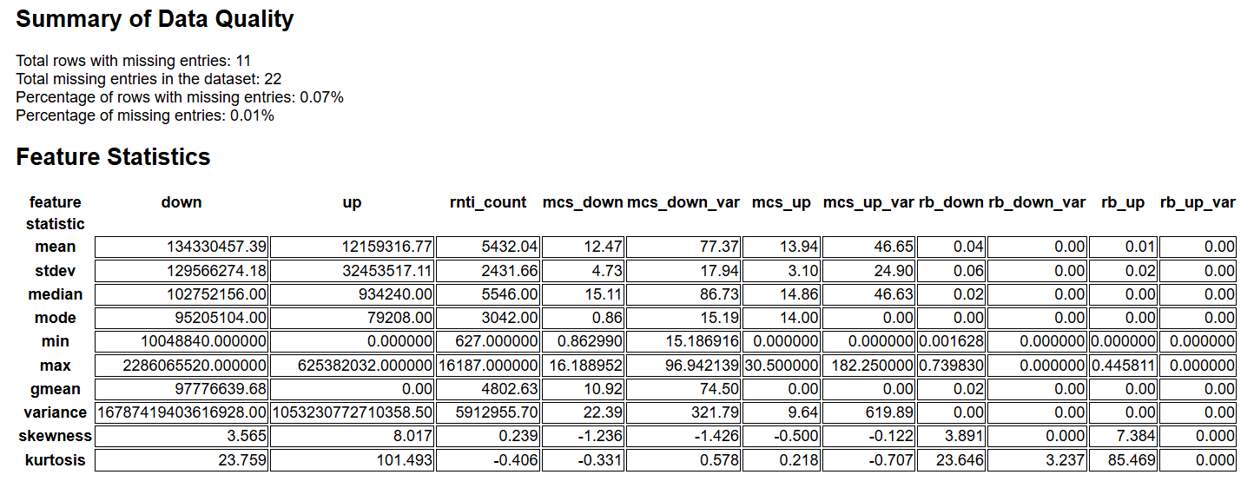
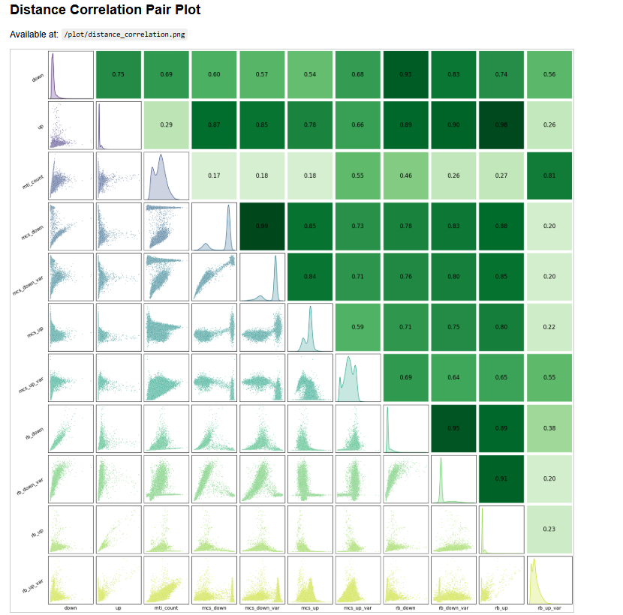
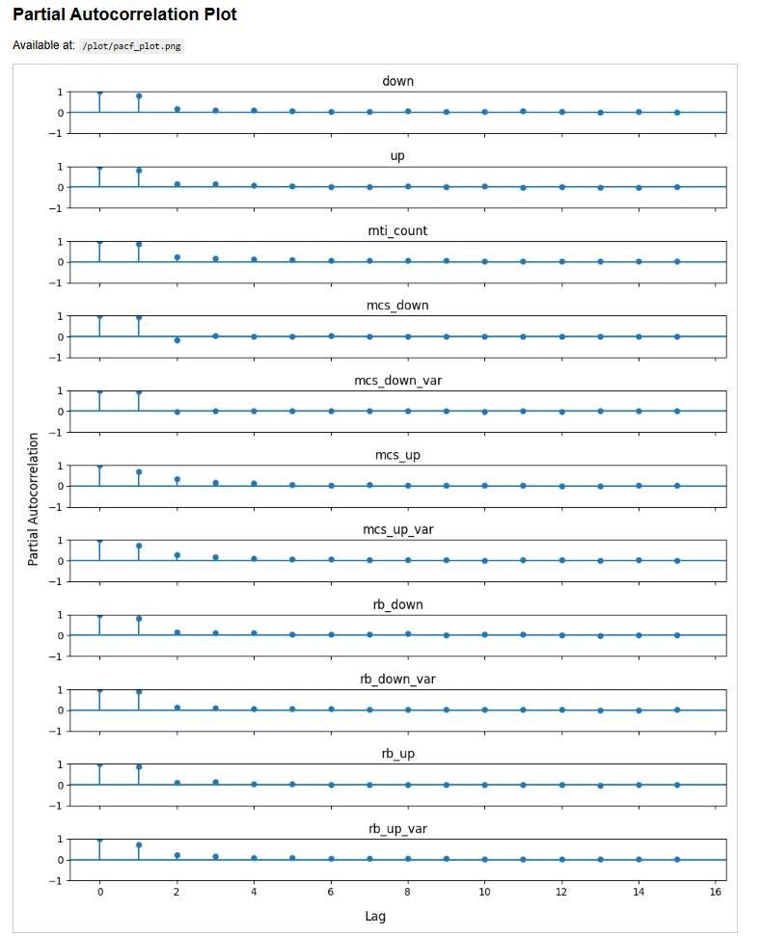
EDA Container
Step one – Exploratory Data Analysis
Reads multivariate time-series from 3 LTE base stations in Barcelona: ElBorn, LesCorts, and PobleSec.
Evaluates data quality, feature statistics and distributions, feature cross-correlations (via distance correlation and PCA).
Generates and presents plots and statistical summaries for user inspection.
Exogenous factors are the primary driver of unexpected loads and may be difficult to model.
Notes:
One of the conclusions from the paper was that preprocessing often has more impact on performance than even the model or aggregator choice.
The dataset contains 267 rows with missing entries, which is just under 1% of all rows. The total number of missing entries is 1704, which is around 0.45% of the entire dataset. Because the volume is low and distribution appears random, we decided to handle missing data via simple imputation rather than more complex interpolation.
For scaling, the team initially considered MinMax normalization. However, the problem is that LTE traffic data contains high spikes—periods of network overload—that skew the scale drastically. This breaks the integrity of the normalized inputs. Z-score normalization, which centers around the mean and uses standard deviation, is more appropriate here and was suggested by our data scientist as a stable alternative.
Evaluation is another place where perspective matters. The paper reports MAE, RMSE, and NRMSE, which are great for benchmarking across stations. However, in operational settings, we care most about extreme traffic—those moments where prediction errors lead to over- or under-provisioning. This means our models must perform well on the tails, not just the average case.
That’s where flooring and capping come in. The paper explored this and found massive gains. Our team took it further—we used a grid search to empirically determine optimal percentiles for flooring and capping on a per-column basis. This kept the models robust to outliers while preserving the useful structure in the data. This step alone was responsible for a significant drop in prediction error, especially in the ElBorn base station where extreme spikes were most prevalent.
These findings directly shaped our preprocessing container. Everything here is done client-side in the federated analogy: load raw CSVs, clean, normalize, generate lag features, and save preprocessed datasets to a shared volume for model training.

Slide 6
Preprocess Container
Step Two – Data Preprocessing
Fills missing data via K-Nearest Neighbors (KNN) algorithm by default. Also allows user to drop rows if too much missing data is present to accurately infer.
Scales the data for the ML models. Supports all Scikit-Learn scalers (MinMax, Standard, Robust, etc.)
Identifies sampling periodicity and discontinuities in data.
Creates cyclical time features to help model understand seasonality.
Exports processed data as a .parquet with scaler object embedded in metadata.
Recommended Future Addition: Binning spikes and baseline to train different models for each
Notes:
This step does much of the heavy lifting that the paper says had a larger effect on model performance than even aggregation algorithm choice. We replicate that by implementing configurable flooring/capping, normalization per series, and temporal lagging.
This preprocessing is done client-side in the federated analogy, which is why it's containerized and meant to run independently on each dataset. main.py here acts as the entrypoint and is fully CLI-driven. Outputs are saved as .csv files in the mounted shared/ volume for seamless access by downstream jobs.

Slide 7
Train/NonML Container
Step Three – Model Training
Two containers, split based on shared functionality: Train (for deep learning models) and NonML (for traditional statistical models and Prophet)
Train container models (via pytorch):
LSTM (Long-Short Term Memory)
GRU (Gated Recurrent Unit)
TCN (Temporal Convolutional Network)
TETS (Transformer Encoder for Time Series)
Rudimentary xAI for ML models
NonML container models (via StatsForecast and Prophet):
AutoArima
AutoETS
AutoTheta
AutoMFLES
AutoTBATS
Prophet
Notes:
This step does much of the heavy lifting that the paper says had a larger effect on model performance than even aggregation algorithm choice. We replicate that by implementing configurable flooring/capping, normalization per series, and temporal lagging.
This preprocessing is done client-side in the federated analogy, which is why it's containerized and meant to run independently on each dataset. main.py here acts as the entrypoint and is fully CLI-driven. Outputs are saved as .csv files in the mounted shared/ volume for seamless access by downstream jobs.

Slide 8
Inference Container
Step Four – Forecasting
Takes trained models and evaluation data as input (separate from data seen during training)
Forecasts for a specified inference length, always taking real data as input when possible.
When real data runs out, uses own forecasts as input (implementing scheduled sampling for encoder/decoder architectures would improve autoregressive forecasting accuracy)
Recommend for the future to add a metric here for numerical comparison between models (e.g. MAE, MSE, etc.)
Current evaluation presentation is split between native MLflow dashboard (for model data and metrics) and Apache Superset (forecast graphing and comparison to ground truth)
Notes:
This step does much of the heavy lifting that the paper says had a larger effect on model performance than even aggregation algorithm choice. We replicate that by implementing configurable flooring/capping, normalization per series, and temporal lagging.
This preprocessing is done client-side in the federated analogy, which is why it's containerized and meant to run independently on each dataset. main.py here acts as the entrypoint and is fully CLI-driven. Outputs are saved as .csv files in the mounted shared/ volume for seamless access by downstream jobs.

